Slide 1
Looking to find & evaluate the right research?
Scopus has you covered

Slide 2
Turn to Scopus, the world’s most connected research database
23,500+
Journal titles
70+ million
Content records
5,000
publishers
8.3+ million
Conference papers, from over 106K global events
165,000+
Book titles
Scopus is updated daily so you never miss the latest information.

Slide 3
Turn to Scopus, the world’s most connected research database
23,500+
Journal titles
70+ million
Content records
5,000
publishers
8.3+ million
Conference papers, from over 106K global events
165,000+
Book titles
Scopus is updated daily so you never miss the latest information.

Slide 4
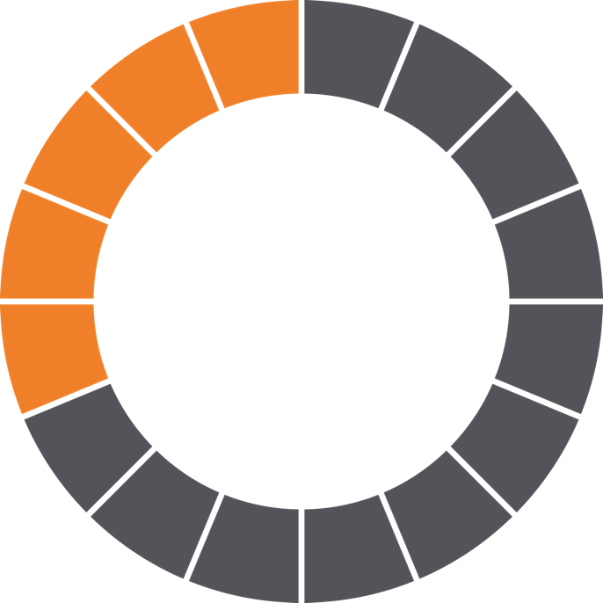
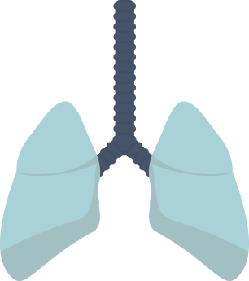
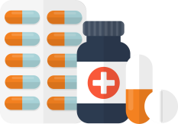
Turn to Scopus
for broad coverage across all subject areas
Health
Sciences
31%
Search across 13,700+ Health Science titles; 31% of Scopus publications.

Slide 5
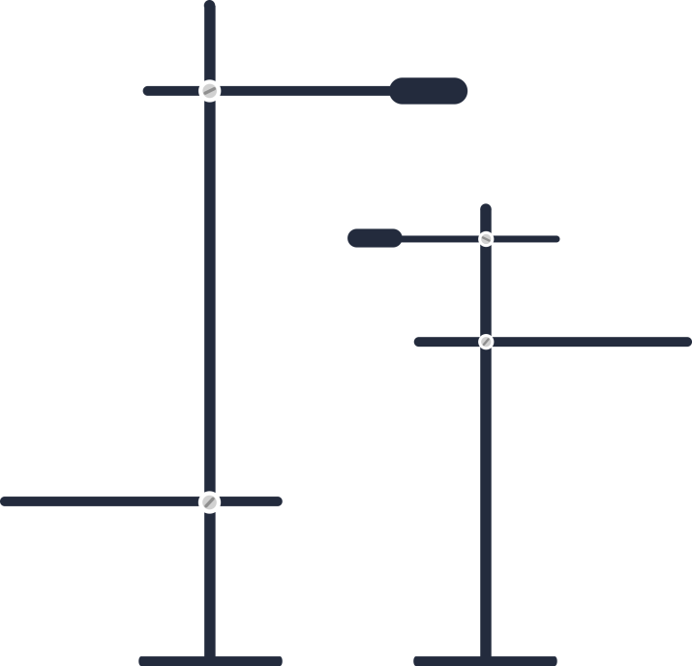
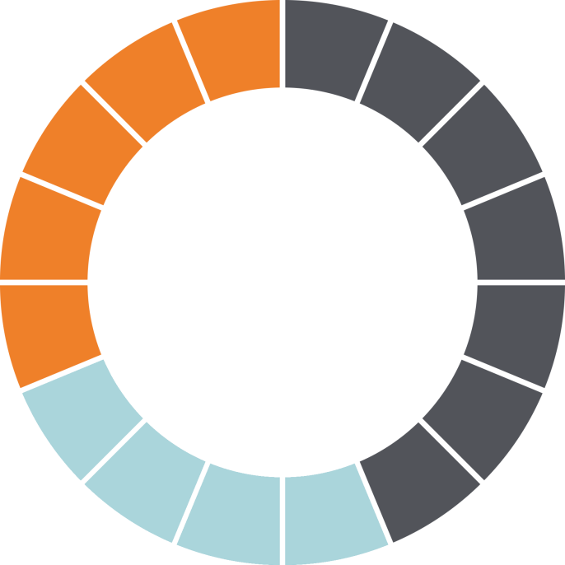
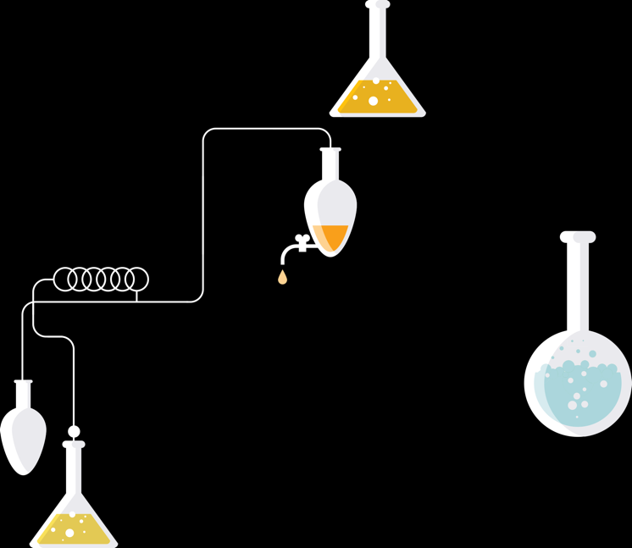
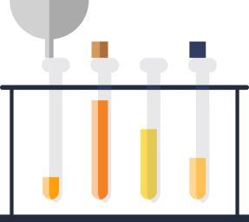
Turn to Scopus
for broad coverage across all subject areas
Physical
Sciences
28%
Search across 12,100+ Physical Science titles; 28% of Scopus publications.

Slide 6
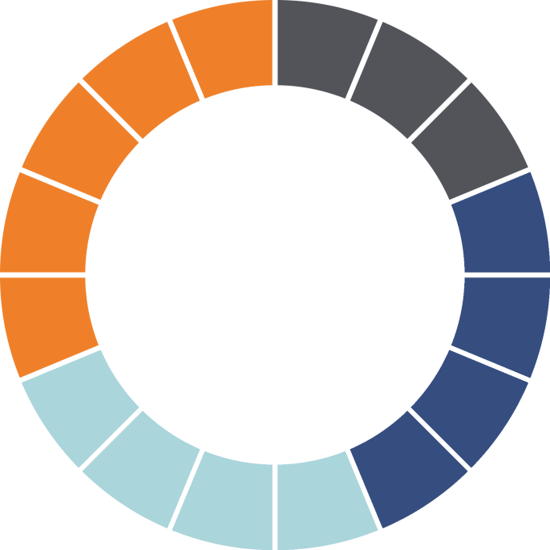
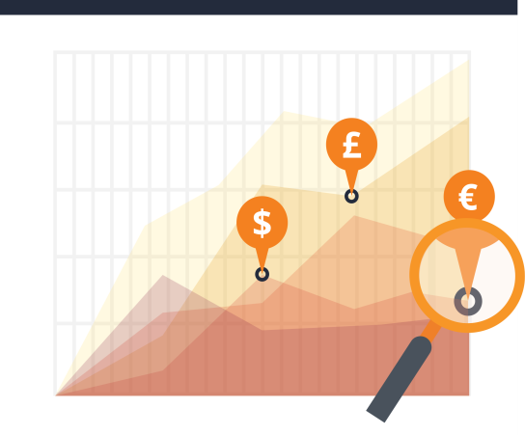
Turn to Scopus
for broad coverage across all subject areas
Social
Sciences
25%
Search across 10,600+ Social Science titles, including Arts & Humanities.

Slide 7
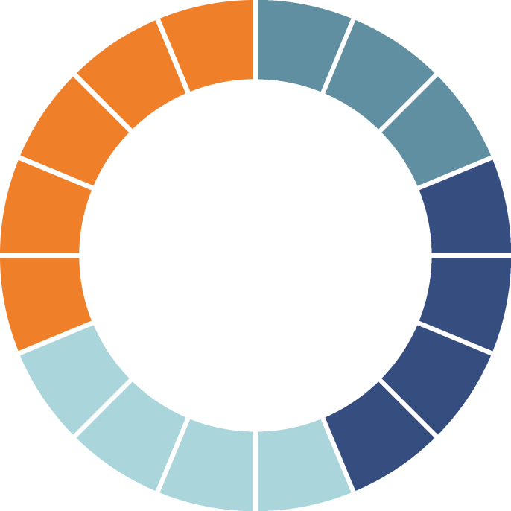
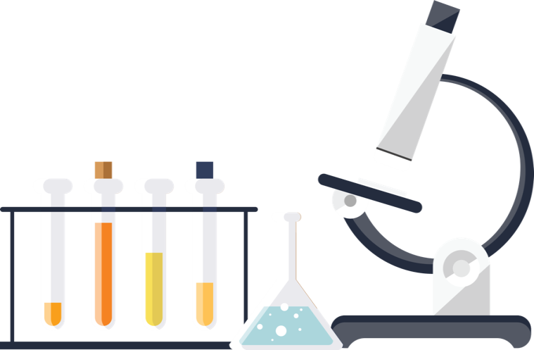
Turn to Scopus for broad coverage across all subject areas
Life
Sciences
16%
Search across 6,700+ Life Science titles; 16% of Scopus publications.

Slide 8
Turn to Scopus, the world’s most connected research database
17% are active Gold Open Access titles
Out of 23,500
Journal titles…
Scopus is updated daily so you never miss the latest information.

Slide 9
Turn to Scopus, the world’s most connected research database
17% are active Gold Open Access titles
Scopus is updated daily so you never miss the latest information.

Slide 10
Scopus is your first step to…
MY TASKS:
Discover what research exists globally
Scopus
Effective search tools
get you to the right results quickly.

Slide 11
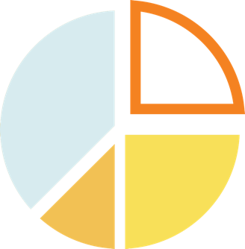
Scopus is your first step to…
MY TASKS:
!
Discover what research exists globally
Look for new ideas and research opportunities
Analytical tools give you insight and a unique view into the data.

Slide 12
Scopus is your first step to…
MY TASKS:
Discover what research exists globally
Look for new ideas and research opportunities
Figure out who to follow and collaborate with
In-depth author and article level metrics help you evaluate research impact.

Slide 13
Scopus is your first step to…
MY TASKS:
Discover what research exists globally
Decide which journal to submit my paper to
Look for new ideas and research opportunities
Figure out who to follow and collaborate with
Measure and compare journal citation impact with the new CiteScore™ metrics, freely available at: JournalMetrics.Scopus.com

Slide 14
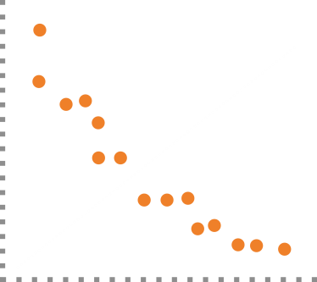
Scopus is your first step to…
MY TASKS:
See if your article is getting noticed.
Discover what research exists globally
Decide which journal to submit my paper to
CITATIONS
Look for new ideas and research opportunities
Evaluate my own success
Figure out who to follow and collaborate with
PAPERS
Monitor you h-index, measure
your article’s research impact.

Slide 15
Scopus is your first step to…
MY TASKS:
Discover what research exists globally
Decide which journal to submit my paper to
Look for new ideas and research opportunities
Evaluate my own success
Figure out who to follow and collaborate with
Make sure my profile is up-to-date
Check the accuracy of your Scopus record and integrate with ORCID.

Slide 16
Research
Present
Write
Research is a complex pursuit, so…
…you need the right tools at your fingertips.
Evaluate
Publish
Collaborate
Scopus: the right information, the right tools, at the right time.

Slide 17
Are you ready?
We are pleased to offer Scopus Get connected today at scopus.com
Need help getting started?
See your local librarian for assistance.
Visit blog.scopus.com for webinars, news, and tips & tricks.

