Slide 1
Eduqas GCSE English Language
Writing Tasks
Articles

Slide 2
Aims of this presentation
introduce article writing
discuss features of article writing
revisit previous article writing tasks
share tips and look at how to write a successful article
consider sample plans and extracts
provide full marked examples
link to a revision sheet on article writing

Slide 3
Introduction to article writing
What do you need to know?
Audience
Have you been given a specific audience? Who is the article aimed at? What do you need to include to engage the audience?
Purpose
What is your writing trying to achieve? For example, you may need to do one of the following:
Entertain a reader
Give information about a specific topic
Persuade the reader to take action

Slide 4
Introduction to article writing
What do you need to know?
Register
What is the appropriate tone for your writing?
When writing an article you need to consider the topic, audience and purpose of the writing. Sometimes there may be a clue in the task title (for example, produce a ‘lively’ article) that may help you to decide the type of tone that is most suitable.
Format
What do you need to know about layout?
There are no specific rules for an article but you should give your article a clear title. All articles should be organised into paragraphs. Subheadings can be used, if relevant. Do not waste time drawing detailed pictures/illustrations.

Slide 5
Sample examination questions
Writing an article – exam tasks:
Write a lively article for your school/college magazine with the heading: A Teenager’s Guide to Managing Parents. Write your article. [20]
A teenage magazine has invited readers to write articles on topics that people have strong views about. The latest topic is tattoos – are they harmless fun and fashion or something to regret in later life? You decide to write an article on the topic for the teenage magazine, giving your views. Write your article. [20]
A travel magazine is inviting readers to submit articles on places for a good day out for all the family. You decide to write about a place that you know well, where there is a lot to do for everyone in the family. Write your article. [20]
Sample exam questions

Slide 6
Getting to grips with writing an article
Write a lively article for your school/college magazine with the heading:
A Teenager’s Guide to Managing Parents. [20]
To help you plan a response to this question, can you answer the following questions?
Questions
Do you know the types of features you might see in an article?
The audience you are writing for is other teenagers. How will you appeal to them? What tone or techniques will you use?
Make a list of things that teenagers might find difficult about their parents.
Make a list of things that teenagers can do to help them ‘manage’ or get along better with their parents.

Slide 7
Planning an answer
A travel magazine is inviting readers to submit articles on places for a good day out for all the family. You decide to write about a place that you know well, where there is a lot to do for everyone in the family.
Write your article. [20]
Ask yourself the following questions to help you plan your answer:
Who is the audience for the writing?
What is the topic of the article?
Do any of the words in the tasks suggest the tone for your writing (‘good day out’)?
How can you appeal to the audience?
What is a travel magazine?
Can you think of any features of an article?
Can you think of any techniques that you might like to include?

Slide 8
Planning an answer
A travel magazine is inviting readers to submit articles on places for a good day out for all the family. You decide to write about a place that you know well, where there is a lot to do for everyone in the family.
Write your article. [20]
A place for a good day out for the family…
Introduction: establish where you are writing about. Try to grab the reader’s attention. Set the tone for the article. Include a brief overview of the day out.
Paragraph 1: Select an aspect of the day out that will appeal to the reader – for example, the location. Describe the location and include details that appeal to the family.
Paragraph 2: Select another aspect of the day out that will appeal to the reader – for example, the activities. Describe what you can do and give advice, for example: time, price, fun.
Paragraph 3: Select a final aspect of the day out that will appeal to the reader – for example, eating out. Include anecdotes, advice and suggestions.
Conclusion: Summarise the day out. Give a few final points to persuade the reader. Make it personal!

Slide 9
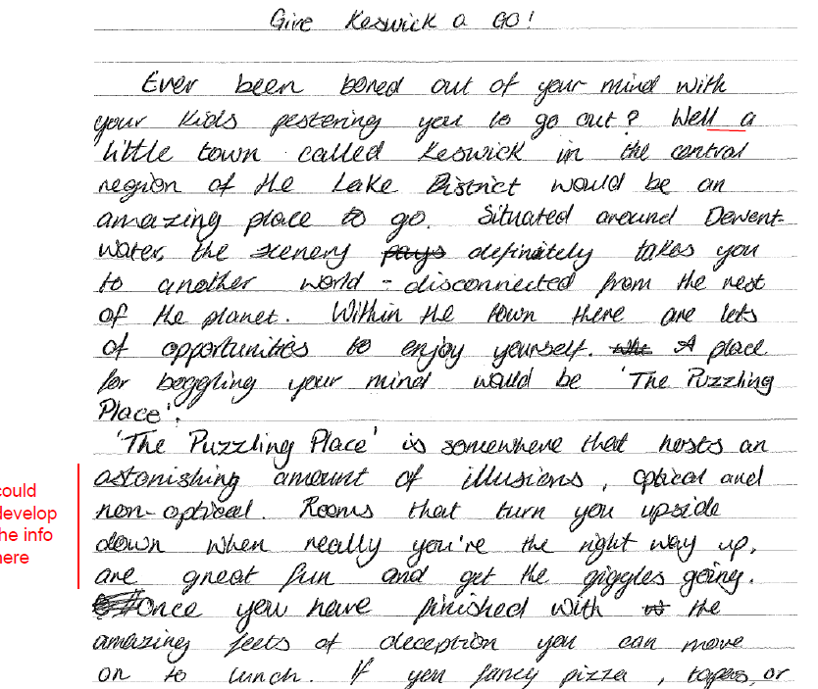
Article writing – sample extract
A travel magazine is inviting readers to submit articles on places for a good day out for all the family. You decide to write about a place that you know well, where there is a lot to do for everyone in the family.
Write your article. [20]
Look at the opening paragraphs
then look back at the plan on the
previous page. Can you see how
the plan has helped the student
to write this answer?

Slide 10
Article writing – sample answer
A travel magazine is inviting readers to submit articles on places for a good day out for all the family. You decide to write about a place that you know well, where there is a lot to do for everyone in the family.
Write your article.
The following slides contain a marked answer to this task. Read the article and think about:
the errors that have been underlined by the examiner
the comments made by the examiner
the ways in which you could improve on the content
see if you can correct the spelling errors

Slide 11
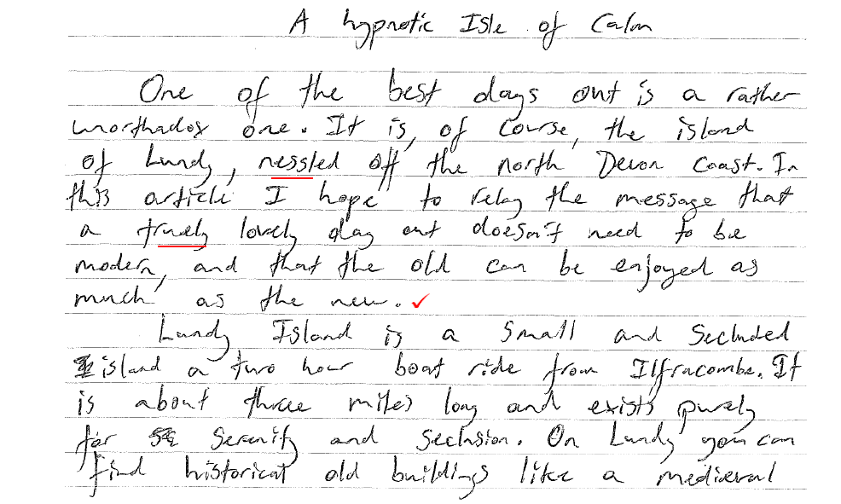
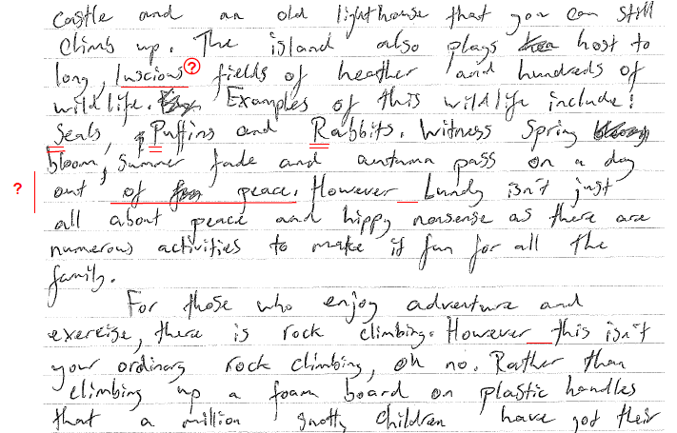
Article writing – sample answer
Map to show location of Lundy Island
Picture of Lundy Castle

Slide 12
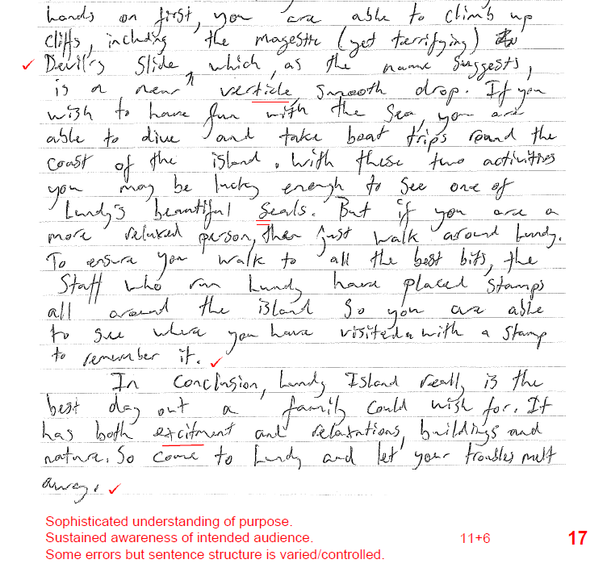
Article writing – sample answer

Slide 13
Article writing – task
A teenage magazine has invited readers to write articles on topics that people have strong views about. The latest topic is tattoos – are they harmless fun and fashion or something to regret in later life?
You decide to write an article on the topic for the teenage magazine, giving your views.
Write your article. [20]
The example that you looked at on slides 13 and 14 had a range of interesting ideas but could have been more accurate.
Use the guidance on how to plan from the previous slides in this presentation and plan your own answer to this question.
When you have a plan that you are happy with spend 25-30 minutes writing an answer to this question.

Slide 14
Making your article effective
So, what’s going on in the world of….MUSIC?’
I’m certain that most of us, at one point or another, have experienced a complaint from irate parents about our tastes in modern music. Be it a harassed shout to ‘Turn that racket down!’ or a wistful ‘We didn’t have lyrics like that when the Beatles were around’, it seems that adults today are generally unimpressed with the new generation of pop culture.
To be fair, not all adults have lost touch with the latest developments in music. However, I’ve given up hope for my own parents. Watching my mum tapping her foot enthusiastically to Harry Styles was enough to put me off watermelons for life. When she turned to me, gave me a knowing wink and claimed he was headed ‘straight for the top’, I was lost for words.
Parents may not like loud music (or swear words), but at least they should be grateful that the majority of us are intuitive enough to avoid the colourful, plastic grasp of ‘pop’ music. It is in this area of music that the worst crimes are most commonly found: repetitive tunes, cliched lyrics, dubbed vocals and an absence of real music.
If you want to produce a successful article, you might like to consider:
techniques to engage the reader – confide in them
write about shared experiences – look at the details about the parents
don’t be afraid to stereotype - the reader will be able to appreciate the point you are making
choose interesting verbs/words to make the writing more interesting
don’t be afraid to have a sense of humour – you can lightly mock others or even yourself
be very specific in the details you include – include place names, proper nouns, titles
using subordinate clauses (asides) to add more details
carefully consider the use of punctuation for effect.

Slide 15
Features of article writing
Dress to Impress?
Haven’t found your style yet?
Not sure what’s ‘in’ and what’s not?
Don’t worry, because help is at hand!
It’s difficult these days to keep up
with trends and fashions. Even
keeping up with your friends is hard enough! What’s ‘hot’ and what’s ‘not’ changes as often as Kylie Jenner’s hair! Not to mention the money issues.
We’ve all been there. Your mates have decided to go ‘punk’ this month and you’ve just gone out and bought your new gear. You’re chuffed with the fishnet tights, and still getting over having your nose pierced, when quicker than you can say ‘I’m a punk chick’, the trend has changed and you are so five minutes ago (and broke)!
The latest fashion hot spot has got to be the mini, mini shorts. You know, those teeny little denim things you’ve seen that gorgeous, leggy girl next door wearing. Well, do not despair! If, like most of us modest females, you absolutely hate your legs….and all the rest of it. Then don’t. Just because Victoria Beckham does, and your best mate says you’ve just got to, it doesn’t mean you are going to be the only one not flashing your thighs. My advice to you is wear what you like. Wear what you feel comfortable in and what makes you feel like a million dollars!
Who cares if tiny skirts are hot this month? It’ll just be something else next month. So save your money girls, and spend it on making yourself feel good.
Picture of fashion icons
Do not waste time drawing pictures, just write down what you would have a picture of.
Include a heading. If you can,
try to think of something
catchy. You could use a pun, a
question or even something
controversial.
Always organise your writing
into paragraphs. It will help you to make your ideas clear and easy to follow.
Appeal to your reader. Use pronouns, be friendly, empathise and use asides.
Vary your punctuation, where relevant. Different sentence types can make your writing more engaging and effective.
Use language to appeal to the reader. Try to use topic specific language too.

Slide 16
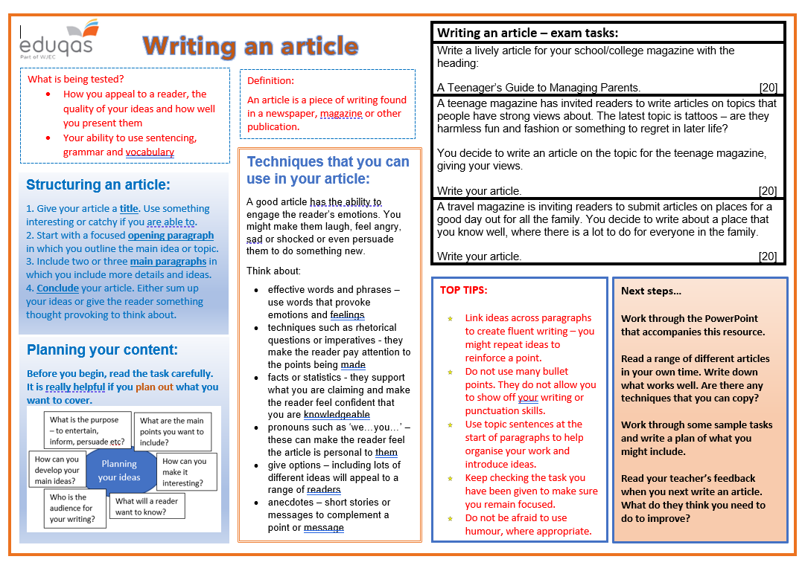
Revision sheet

Slide 17
Finally…
We hope this resource has been helpful to you.
For further information and resources for GCSE English Language you can visit the digital resources section of our website. The following link will take you there:
https://resources.eduqas.co.uk/Pages/ResourceByArgs.aspx?subId=11&lvlId=2

